Slide 1
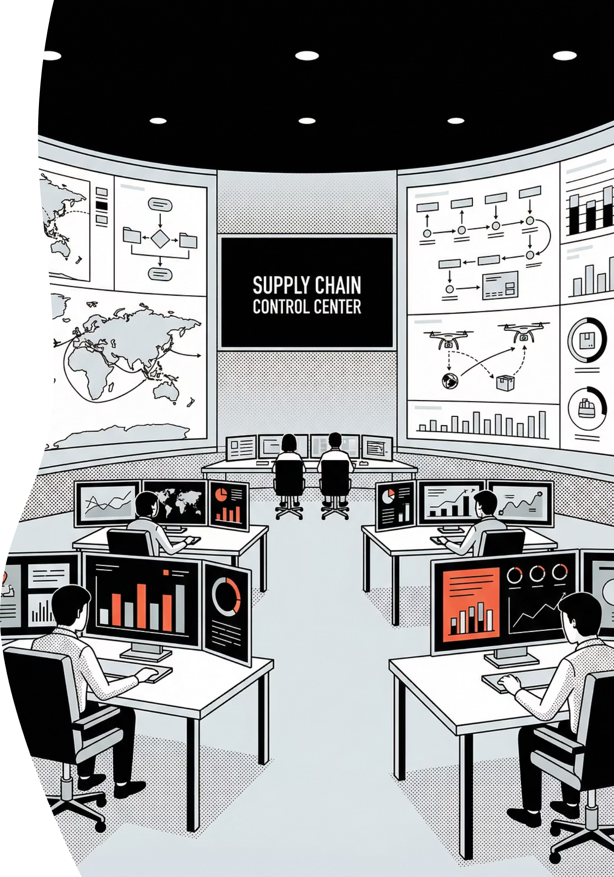
Smart Supply Chain Analytics & AI Insights
Transforming data into real-time decisions with Power BI intelligence
Presented by: Jagathishwaran Parthiban
Domain: Data Science
Date: 10th January 2026

Slide 2
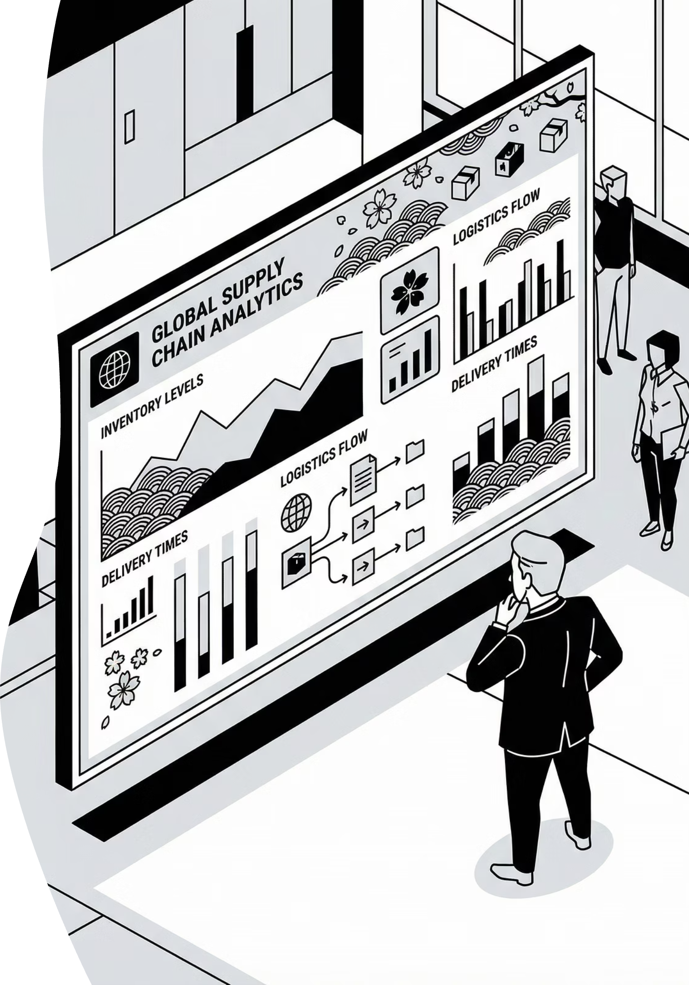
PROJECT OVERVIEW
Building Intelligence Into Supply Chain Operations
Primary Objective
Core Focus Areas
Deploy an end-to-end Power BI analytics platform delivering real-time visibility, profit optimization, and AI-driven insights across the entire supply chain ecosystem.
Inventory optimization & stock management
Sales performance & profitability analytics
Operational performance metrics
AI-powered strategic decision support

Slide 3






CRITICAL CHALLENGES
Complex Problems Requiring Smart Solutions
Inventory Imbalance
Margin Erosion
Return Impact
Simultaneous overstocking and stockout risks creating inefficiency and lost opportunities
Strong sales volume undermined by aggressive discounting strategies reducing profitability
Product returns creating significant profit leakage across categories
Visibility Gap
Loss Identification
No unified view connecting sales, inventory, and performance metrics
Inability to pinpoint loss-making products, regions, and sales personnel
The Solution
A unified Power BI platform combining advanced analytics with AI-driven insights for smarter, faster supply chain decisions.

Slide 4

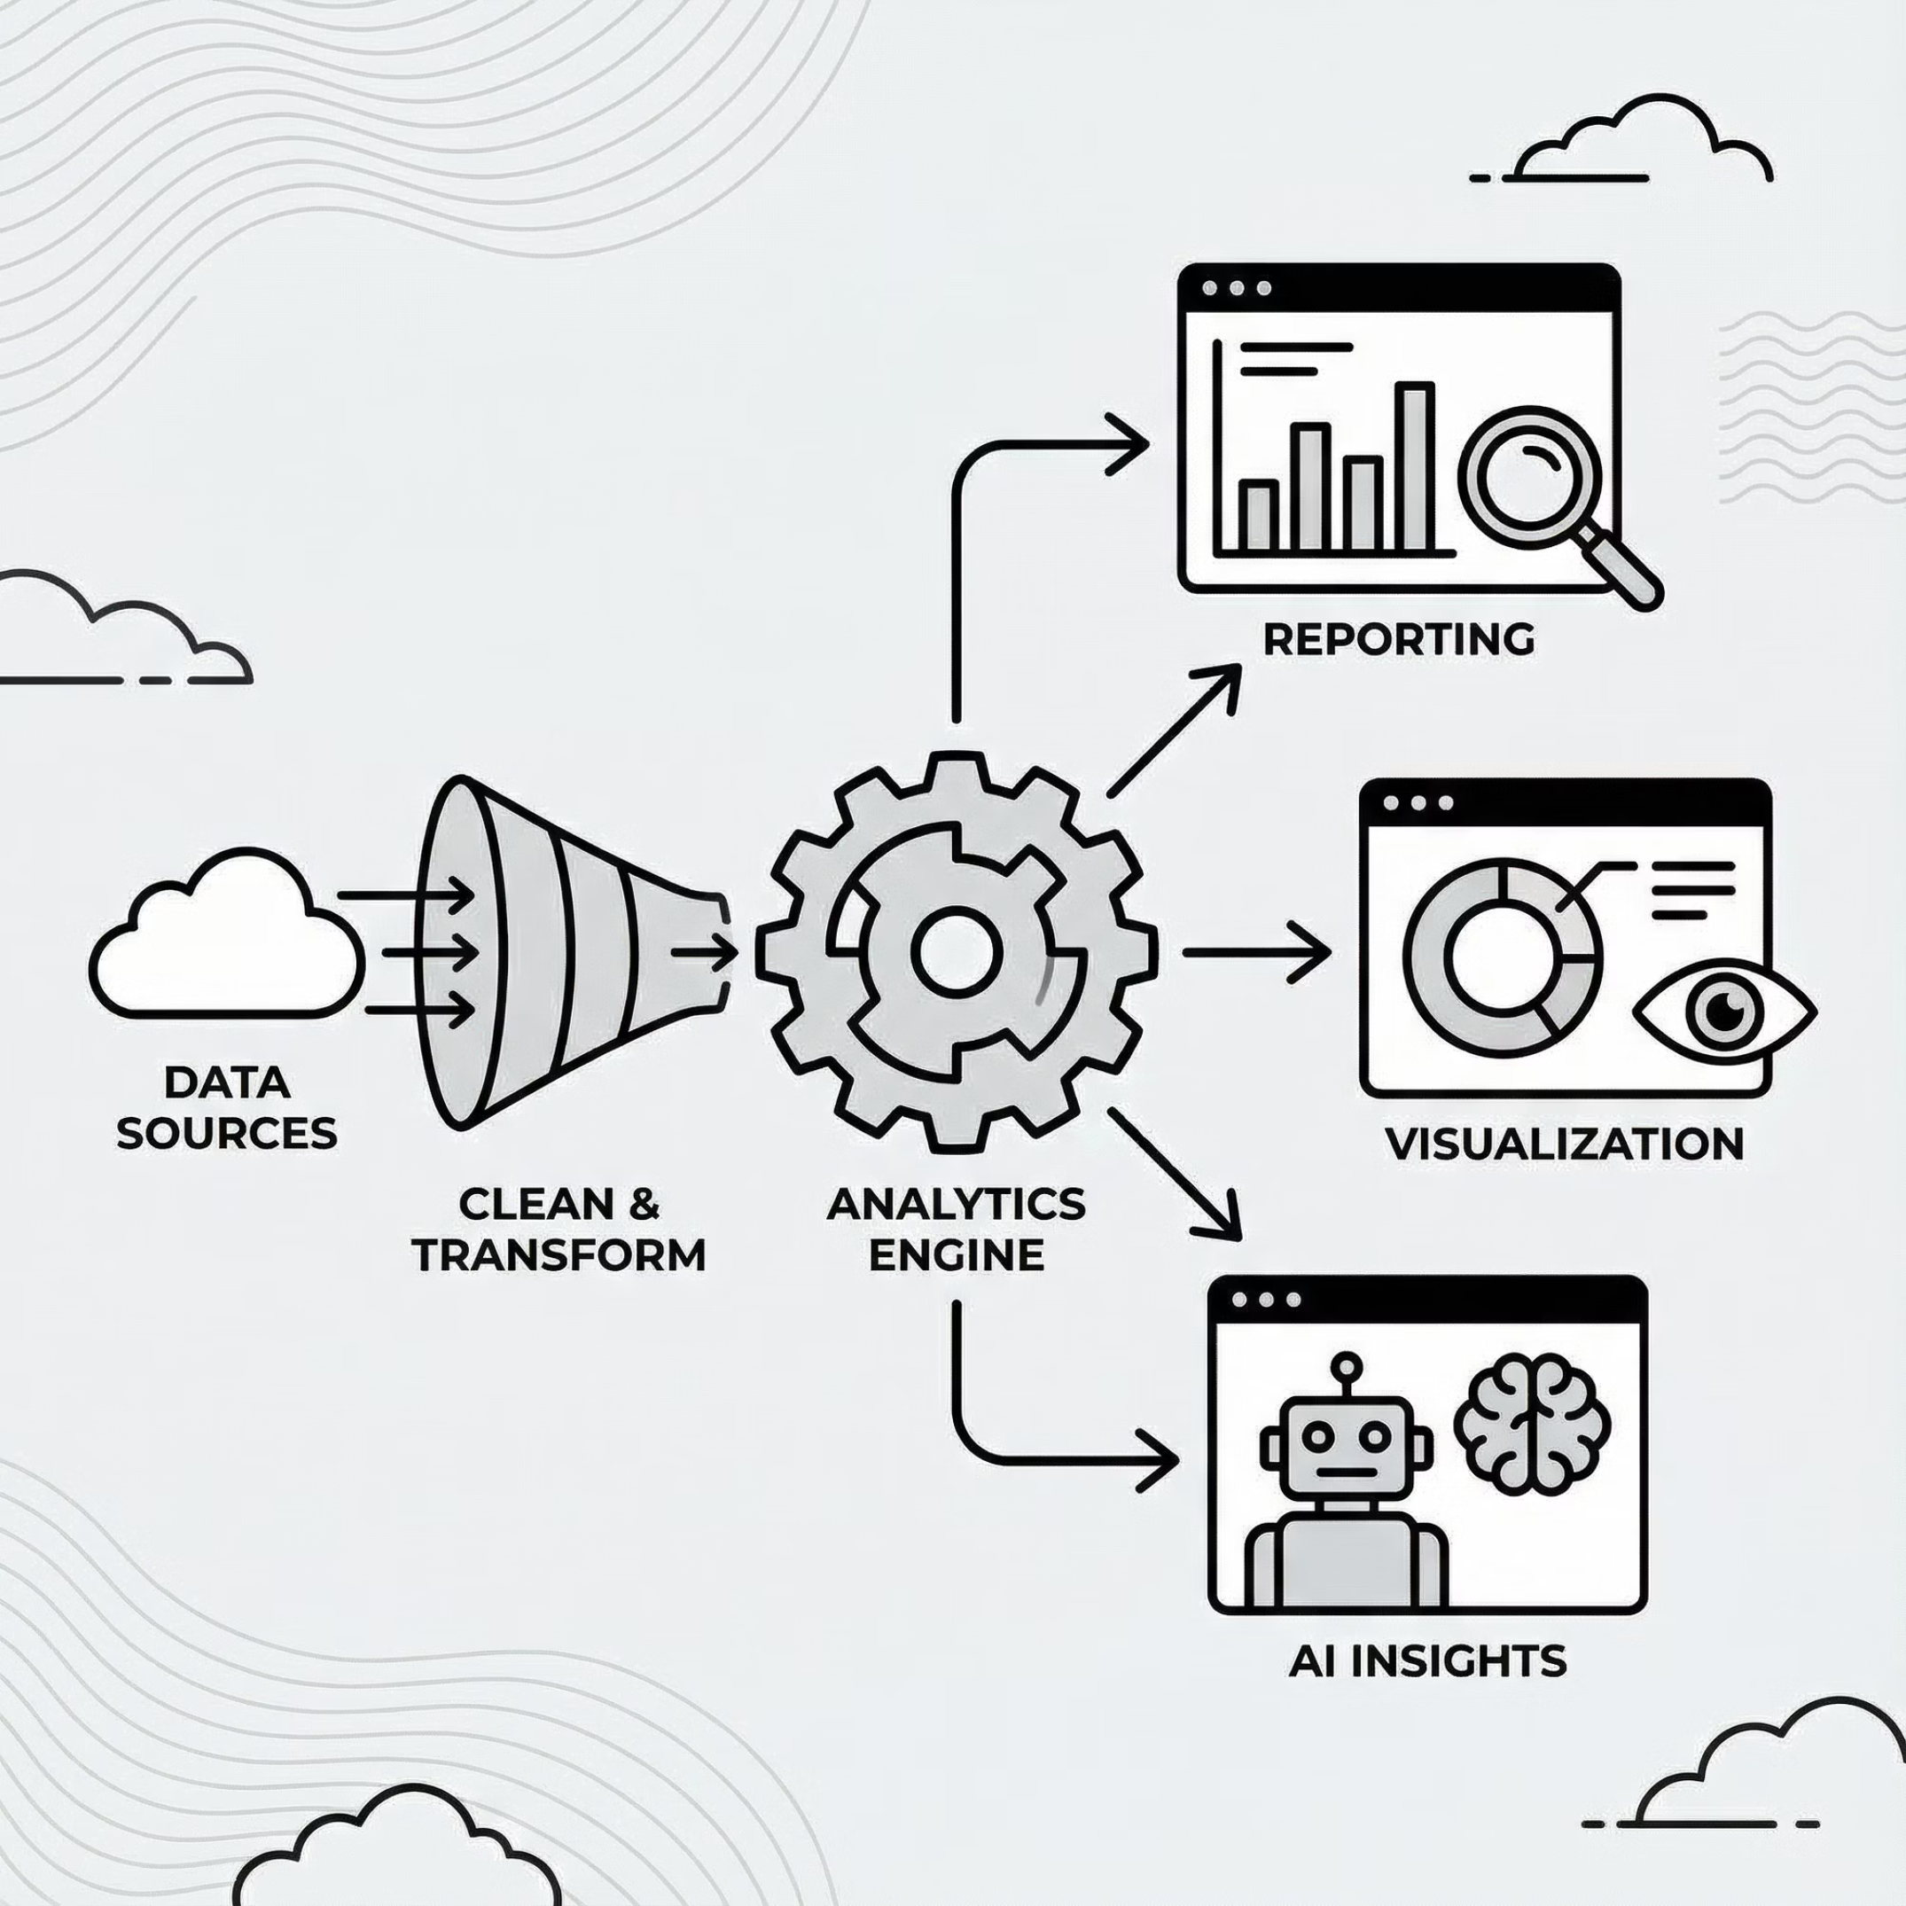
SYSTEM ARCHITECTURE
Integrated Dashboard Framework
Smart Inventory Management
Sales Analytics
Real-time stock tracking and optimization
Revenue and profitability insights
Performance Insights
AI Strategy Engine
KPI monitoring and trend analysis
Intelligent recommendations and predictions
Critical Data Dimensions
Product hierarchy: Category & Sub-Category
Geography: Region & City
Customer segmentation
Sales force attribution
Financial metrics: Discounts, Returns, Profit
Result: Complete end-to-end supply chain visibility enabling proactive decision-making across all operational levels.

Slide 5

INVENTORY INTELLIGENCE
Smart Inventory Management Dashboard
17
16M
5
38K
Product Categories
Units in Inventory
Low Stock Alerts
Units Sold
Full portfolio coverage
Total stock on hand
Items below 10K threshold
Current period movement
Operational Insights
Loss Prevention Analytics
Fast-moving vs slow-moving product identification
Products with high return rates
Automated restock and clearance recommendations
Discount impact on profitability
Category-level demand forecasting
Geographic loss pattern detection
Business Impact
Optimized stock levels reduce holding costs by 15-20% while preventing costly stockouts and improving cash flow efficiency.

Slide 6





Strategic Inventory Optimization Framework
Fast-Moving Products
Slow-Moving Products
Action: Immediate replenishment priority
Action: Strategic clearance campaigns
Automated reorder triggers prevent stockouts on high-velocity items generating consistent revenue.
Targeted promotions and bundle strategies free capital tied up in aging inventory.
Loss-Making SKUs
Geographic Patterns
Action: Discount policy revision
Action: Regional corrective measures
Products with combined high discounts and returns require immediate margin protection.
Location-specific strategies address unique market conditions and performance gaps.
Decision Support Framework
Margin Protection
Warehouse Optimization
Risk Mitigation
Implement discount guardrails and approval workflows
Reallocate stock based on regional demand patterns
Balance prevention of stockouts and overstock scenarios

Slide 7

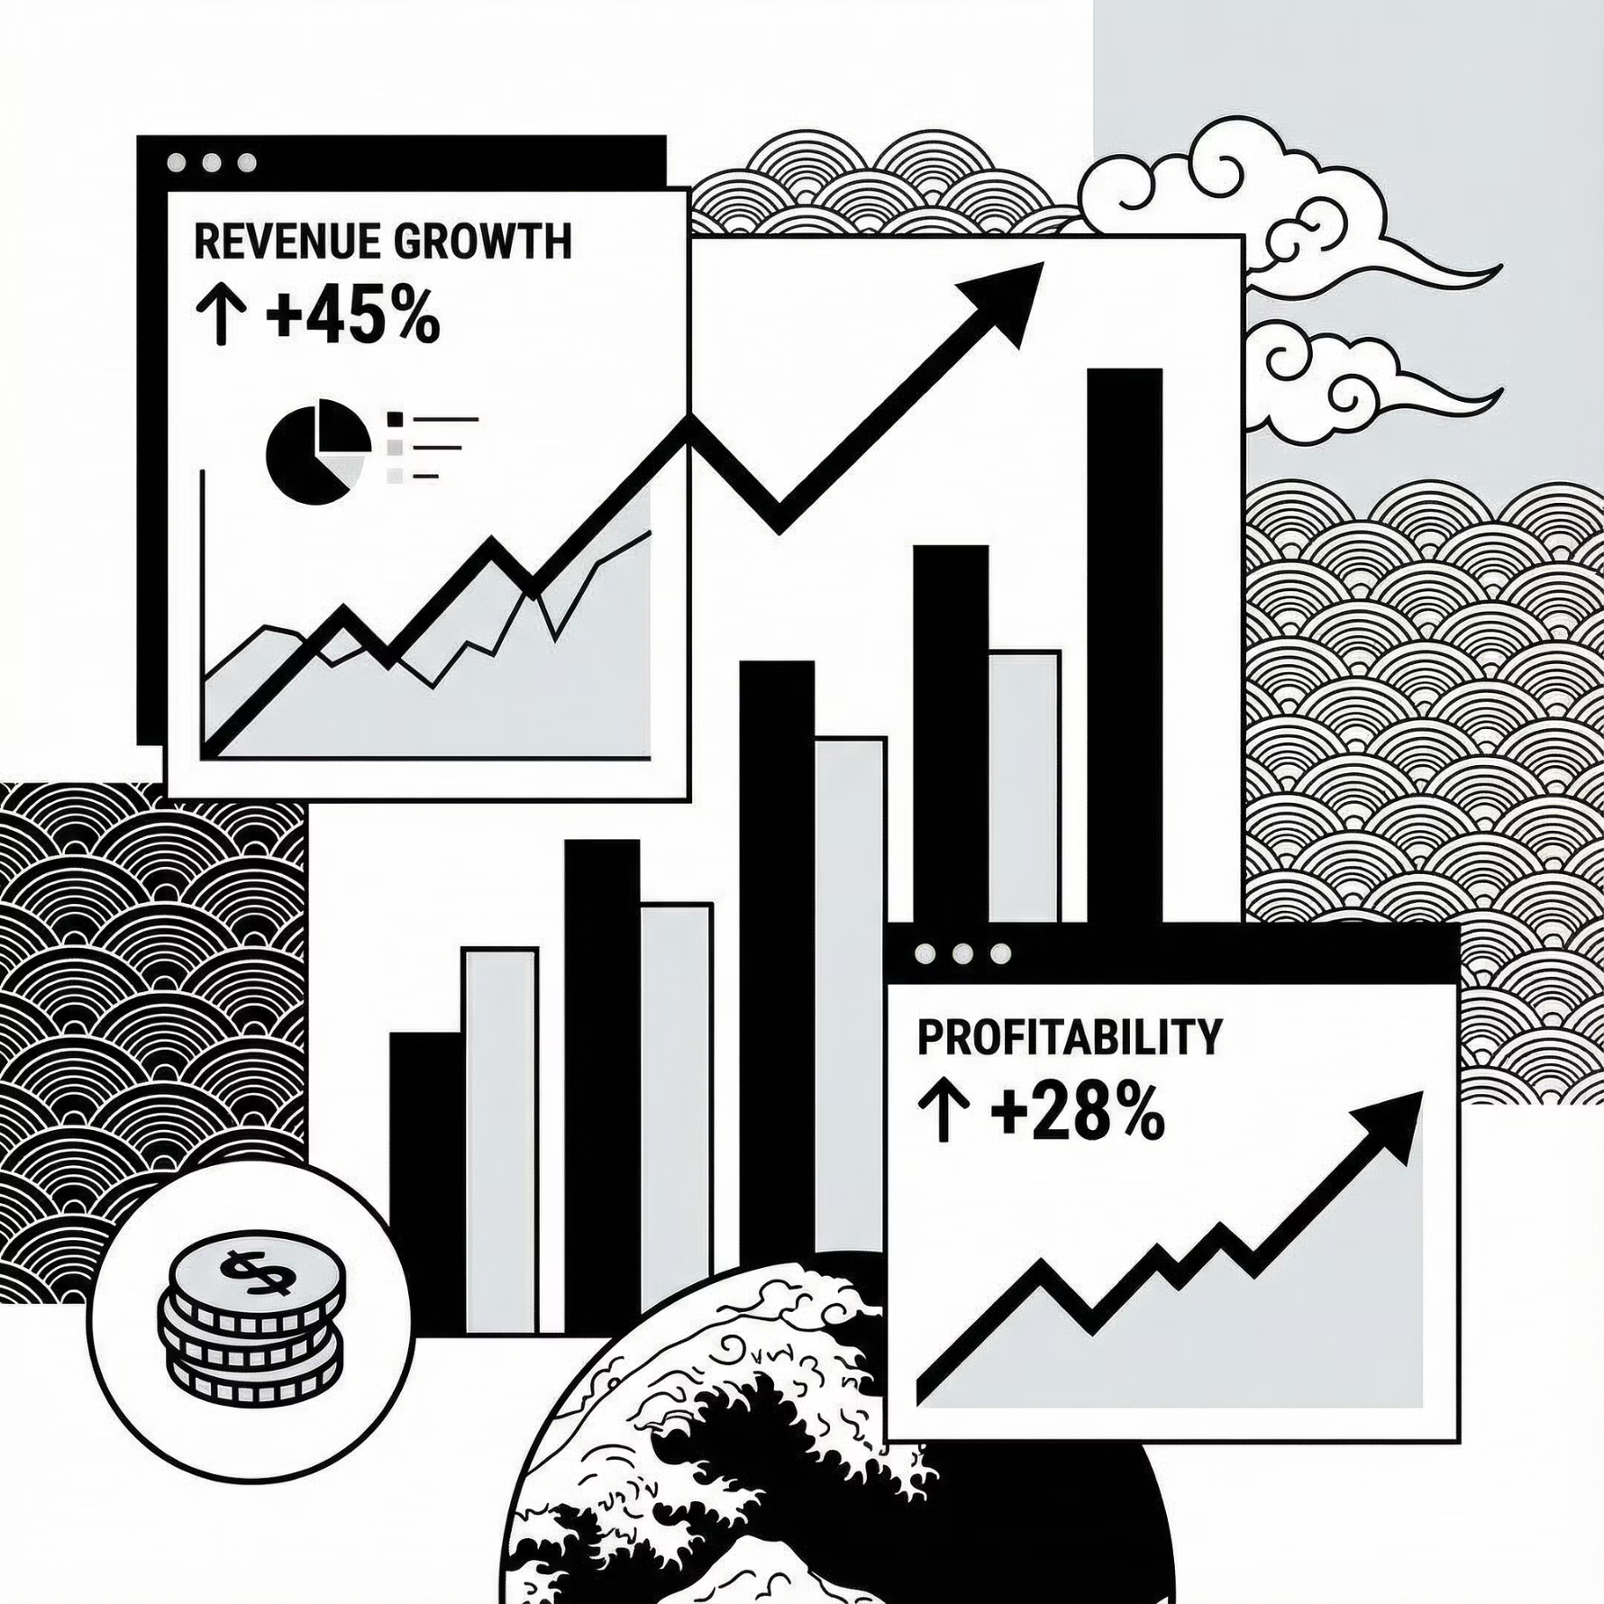


REVENUE INTELLIGENCE
Sales Analytics Dashboard
Financial Performance
Total Sales: ₹2.30M in current period
12.46%
2.54%
Total Profit: ₹286K generated
Total Orders: 9,994 transactions processed
Average Order Value: ₹230 per transaction
Profit Margin
Sales Growth
Month-over-month increase
Overall profitability rate
01
Top-Performing Products
Identify revenue drivers and margin leaders across categories
03
Category Contribution
Sales and profit distribution across product lines
02
Discount Impact Analysis
Quantify margin erosion from promotional strategies
04
Trend Analysis
Monthly performance patterns and seasonality insights
Strategic Outcome: Clear distinction between revenue generation and profit creation, enabling smarter resource allocation and pricing strategies.

Slide 8
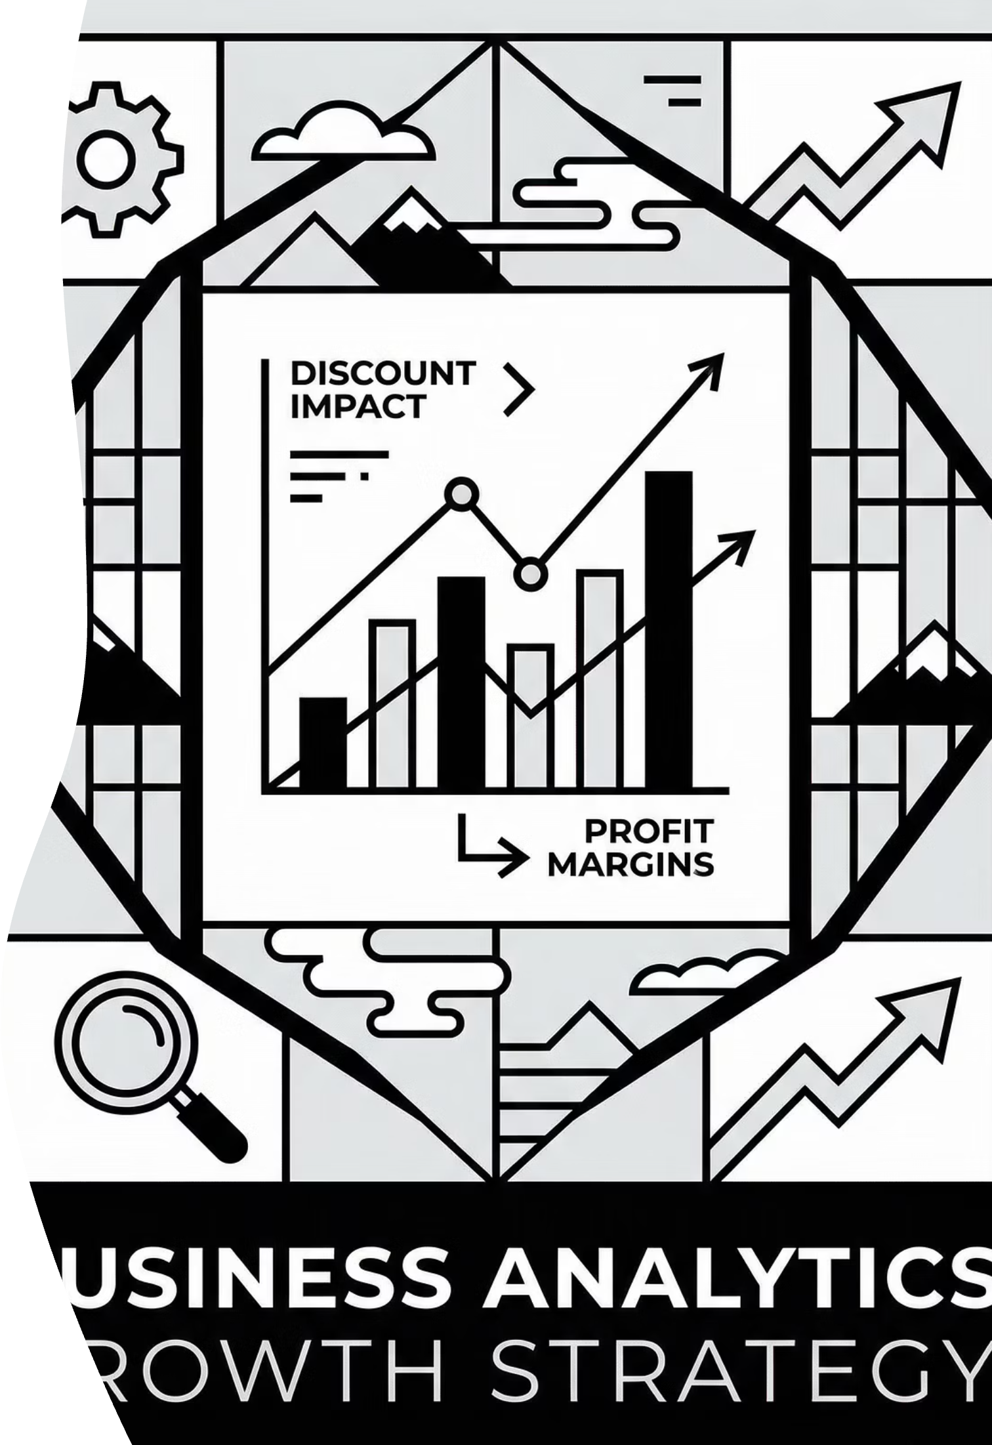

The Discount Dilemma: Sales vs. Profitability
Critical Finding
Root Cause
Multiple sub-categories demonstrate high sales volume paired with negative profit margins
Aggressive discounting strategies directly eroding profitability across product lines
Compounding Factor
Product returns combined with discounts create severe profit leakage
Visual Analytics Techniques
Scatter Plot Analysis: Discount percentage vs. profit margin correlation
Waterfall Charts: Step-by-step sales impact breakdown
Trend Lines: Month-over-month performance trajectories
Quadrant Analysis: High sales/low profit identification
Strategic Shift Required
Transition from revenue-based sales incentives to profit-based compensation models that reward margin protection and sustainable growth.

Slide 9






EXECUTIVE DASHBOARD
Performance Insights & Profit Analysis
100%
6.4%
14%
Profit Contribution
Return Loss Rate
Discount Leakage
Complete attribution visibility
₹23.23K impact on bottom line
₹322.42K margin erosion
Category & Region Analysis
Customer Profitability
Profit contribution mapping across products and geographic territories
Segment-level profit analysis: ₹360.69 average per customer
Shipping Mode Impact
Sales Force Performance
Logistics cost analysis on final profitability by delivery method
Individual contribution tracking: ₹573.88K average per salesperson
Management Value: Comprehensive visibility into who, where, and why profits are generated or lost, enabling targeted interventions and strategic resource allocation.

Slide 10


AI POWERED
AI-Driven Strategy & Smart Insights
Advanced AI Capabilities
Key Influencers
AI identifies primary drivers of profitability and loss
Decomposition Tree
Root cause analysis drilling into performance factors
Q&A Visual
Natural language queries for instant business answers
Efficiency Quadrant
Sales vs. profit matrix revealing true performance
Strategic Insights Uncovered
Sales ≠ Profit
Geographic Patterns
Category-Specific Risk
High sales volume does not guarantee profitability—discount strategies and returns drive the gap
Specific categories and regions consistently underperform, requiring targeted intervention
Furniture category shows significantly elevated return rates impacting overall margins
Transformational Outcome
AI transforms raw data into actionable strategic recommendations, moving beyond passive reporting to active decision support that drives measurable business results.

Slide 11
Thank You

